Slide 1
Microsoft Power BI

Slide 2
Power BI Dev Camp – Session 5 Embedding Power BI Reports using React.js
Ted Pattison
Principal Program Manager
Customer Advisory Team (CAT) at Microsoft

Slide 3
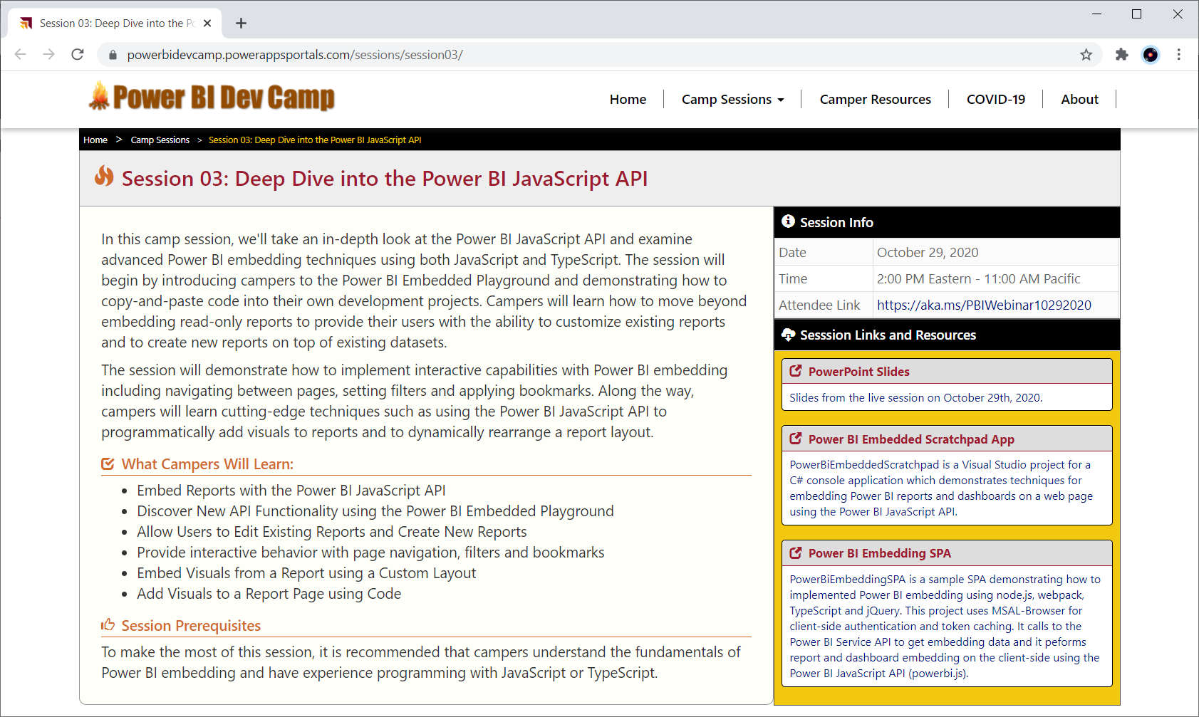
Welcome to Power BI Dev Camp
Power BI Dev Camp Portal - https://powerbidevcamp.net

Slide 4
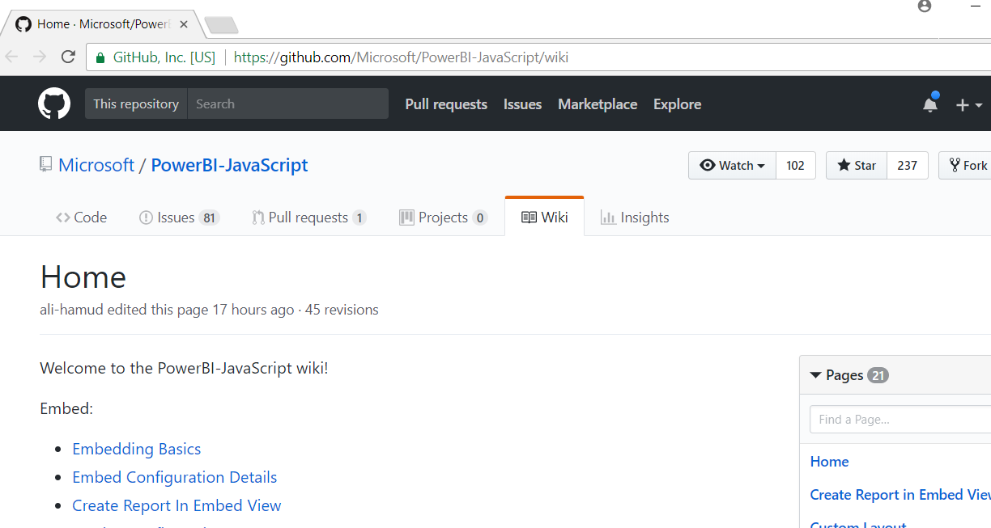
Power BI JavaScript API (powerbi.js)
Power BI JavaScript API used to embed resources in browser
GitHub repo at https://github.com/Microsoft/PowerBI-JavaScript/wiki
GitHub repository contains code, docs, wiki and issues list

Slide 5
Agenda
Getting Started with React.js
Creating SPAs using React.js, TypeScript and Webpack
Authenticating the User using Azure AD
Extending a React Project with the React Router
Calling the Power BI Service API using Fetch
Embedding Power BI Reports
The Power BI React Component

Slide 6
Introducing React
React is a library for building user interfaces
Not as all-encompassing as a framework like Angular
Focused on building HTML-based user experiences
Based on reusable component-based architecture
Components react to state changes by updating UI
React uses shadow DOM for efficient event handling

Slide 7
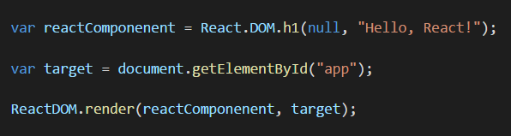
React versus ReactDOM
React and ReactDOM are separate libraries
React (react.js) is the primary library used to build out user experiences
ReactDOM (react-dom.js) is used to render React user experience in the browser
React library exposes global React object
React object is the main entry point into React API
React.DOM wraps standard HTML elements
ReactDOM library exposes global ReactDOM object
ReactDOM object used to render React components on web page

Slide 8
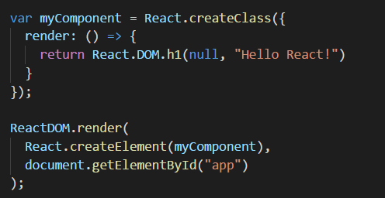
React Component Created Using ES5
React component can be created using EcmaScript 5
React component definition created using React.createClass
React component must be defined with render method
React component can be instantiated with React.createElement

Slide 9
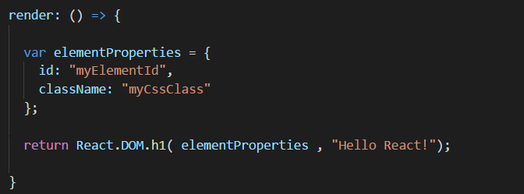
Initializing Element Properties
Elements created using properties object
Object properties used to initialize element properties
Use className instead of class to assign CSS class
Use htmlFor instead of for to define HTML label

Slide 10
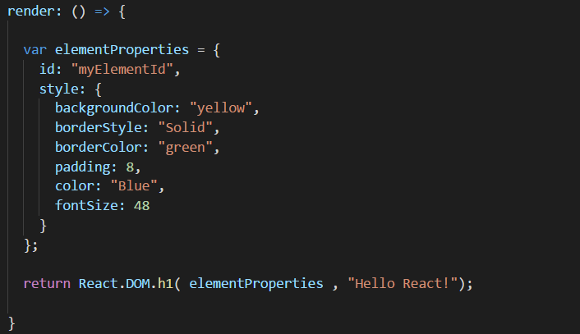
Initializing Element Styles
Elements styles initialized using style object
style must be defined using an object not a string
CSS properties referenced using camel casing

Slide 11
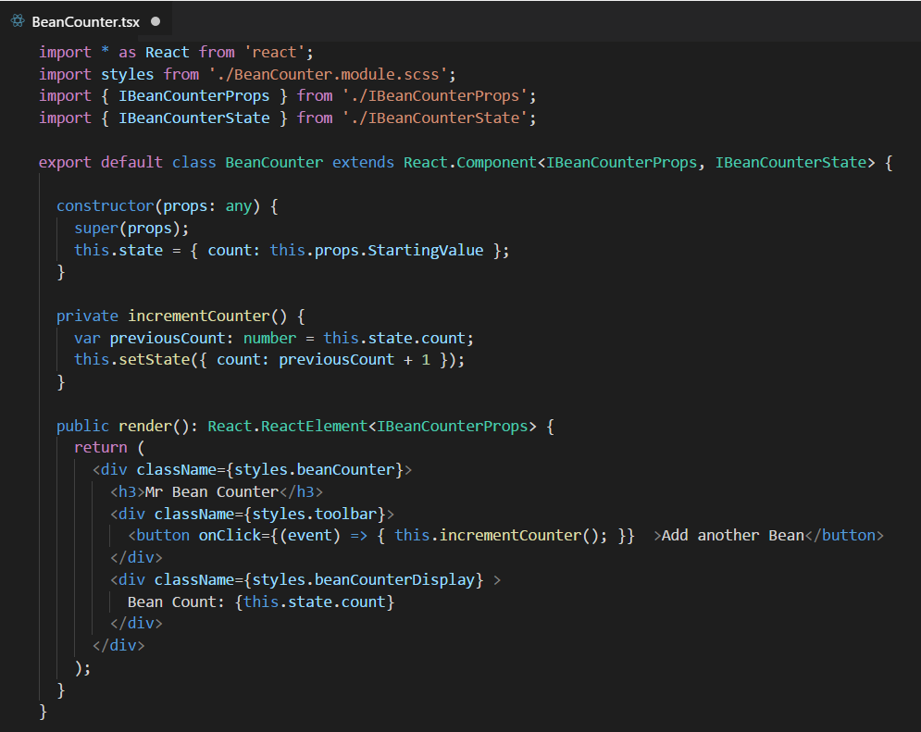
React Provides Synthetic Events
Replaces standard DOM-based event handling
React creates virtual DOM for elements in component
React interacts with real DOM when required
Provides faster event registration and processing
No need to write browser-specific code

Slide 12
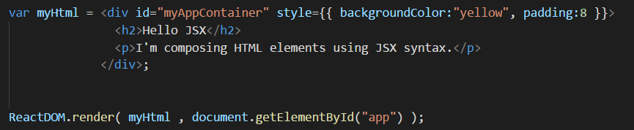
Understanding JSX (and TSX)
JSX provides better syntax for HTML composition
JSX allows extends JavaScript with XML-like syntax
JSX syntax must be transpiled into JavaScript code
JSX/TSX is separate from React library
JSX/TSX commonly used in React development
Babel compiler used to transpile JSX to JavaScript
TypeScript compiler used to transpile TSX to JavaScript

Slide 13
Agenda
Getting Started with React.js
Creating SPAs using React.js, TypeScript and Webpack
Authenticating the User using Azure AD
Extending a React Project with the React Router
Calling the Power BI Service API using Fetch
Embedding Power BI Reports
The Power BI React Component

Slide 14
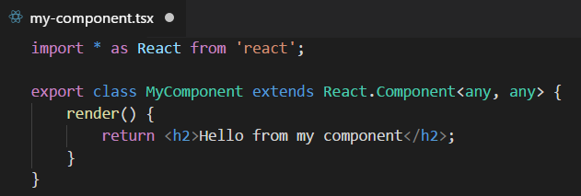
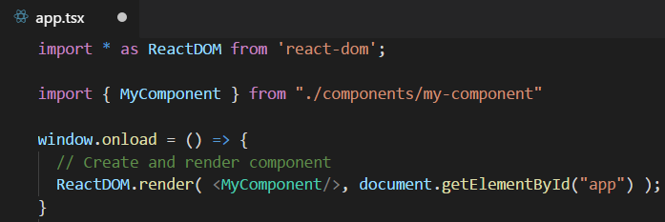
Defining React Components using TypeScript
Component is class extending React.Component
Component usually defined in its own tsx file
Component class must define render method
Component can be instantiated with JSX/TSX syntax

Slide 15
Component Properties and State
Component can contain properties and state
Properties are initialized by external components
Properties are read-only to hosting component
State is set internally by hosting component
Changing state triggers UI refresh by calling render
UI experience created by reacting to changes in state

Slide 16
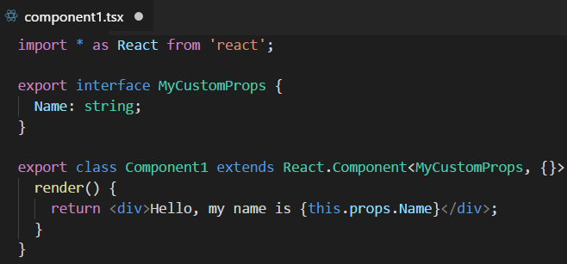
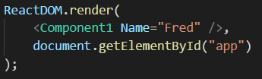
React Component Properties
Defining component with a property
Instantiating component with a property

Slide 17
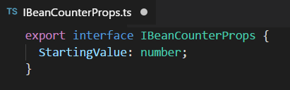
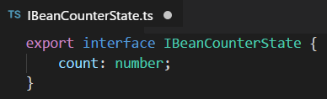
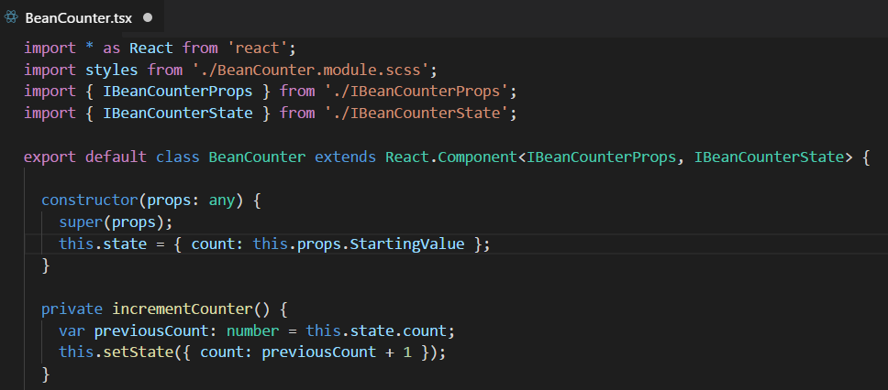
Stateful Component

Slide 18
Stateful Component Rendering

Slide 19
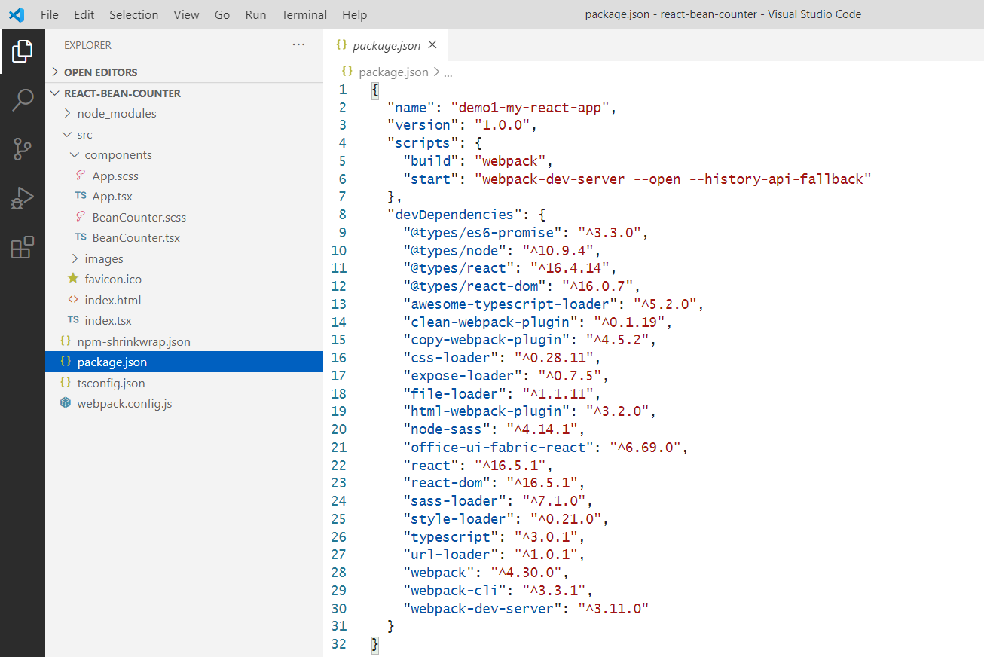
Starter Project - package.json

Slide 20
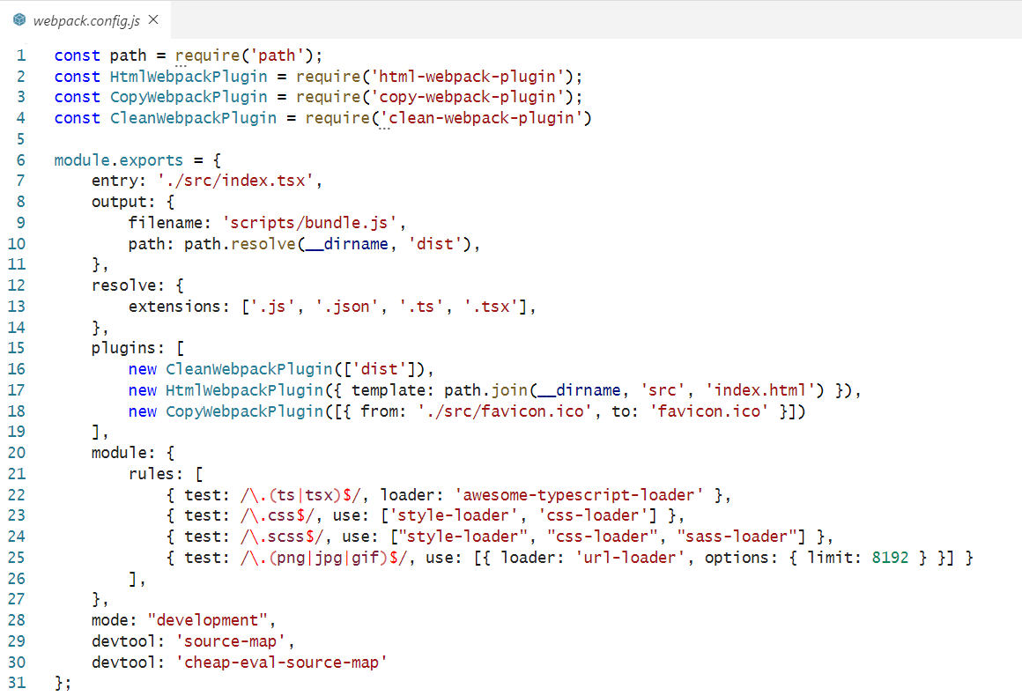
Starter Project - webpack.config.js

Slide 21
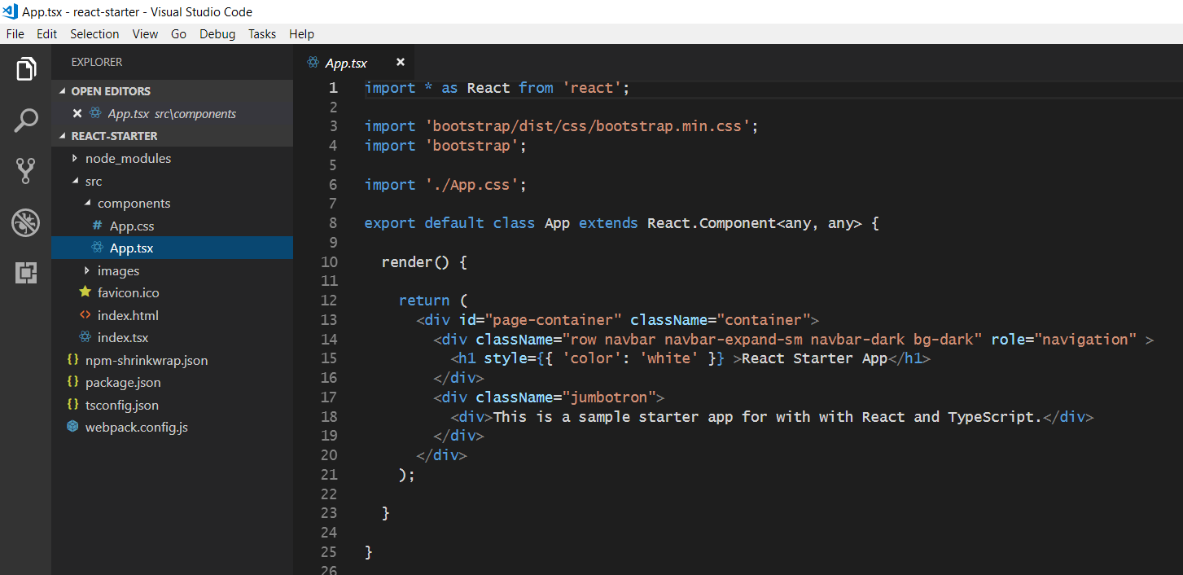
The Top-level App Component

Slide 22
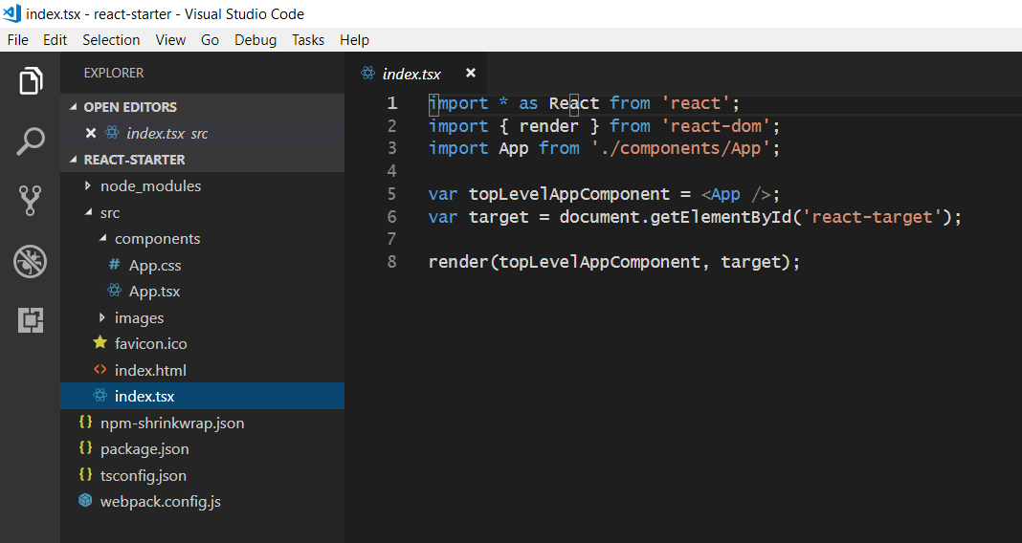
Bootstrapping the App Component

Slide 23
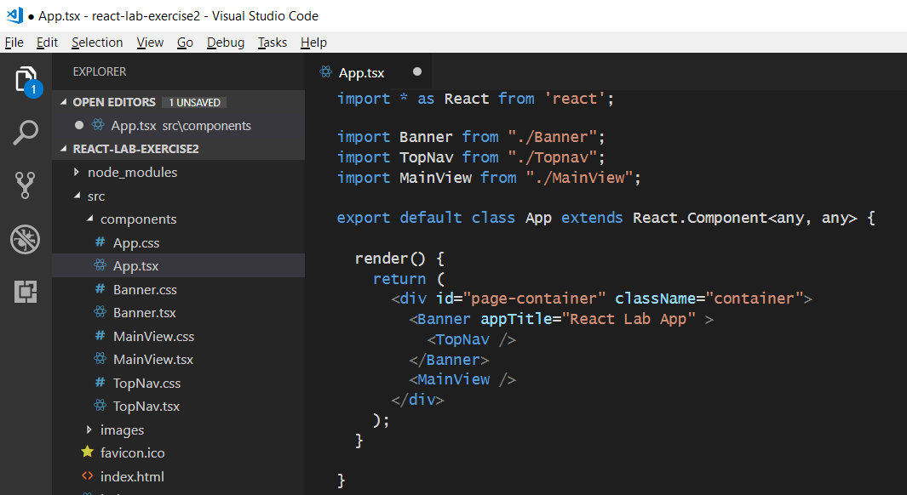
React Component Hierarchies
App
Banner
Topnav
MainView

Slide 24
Agenda
Getting Started with React.js
Creating SPAs using React.js, TypeScript and Webpack
Authenticating the User using Azure AD
Extending a React Project with the React Router
Calling the Power BI Service API using Fetch
Embedding Power BI Reports
The Power BI React Component

Slide 25
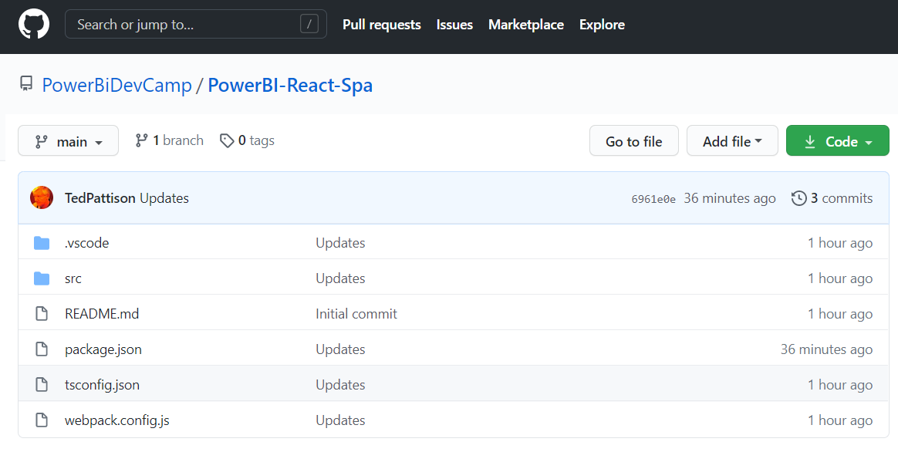
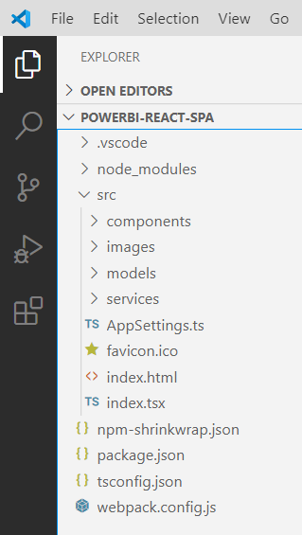
Demo Application: PowerBi-React-Spa https://github.com/PowerBiDevCamp/PowerBI-React-Spa

Slide 26
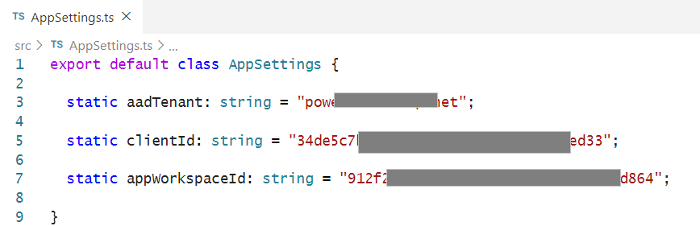
AppSettings.ts

Slide 27
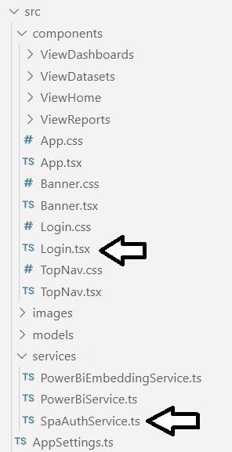
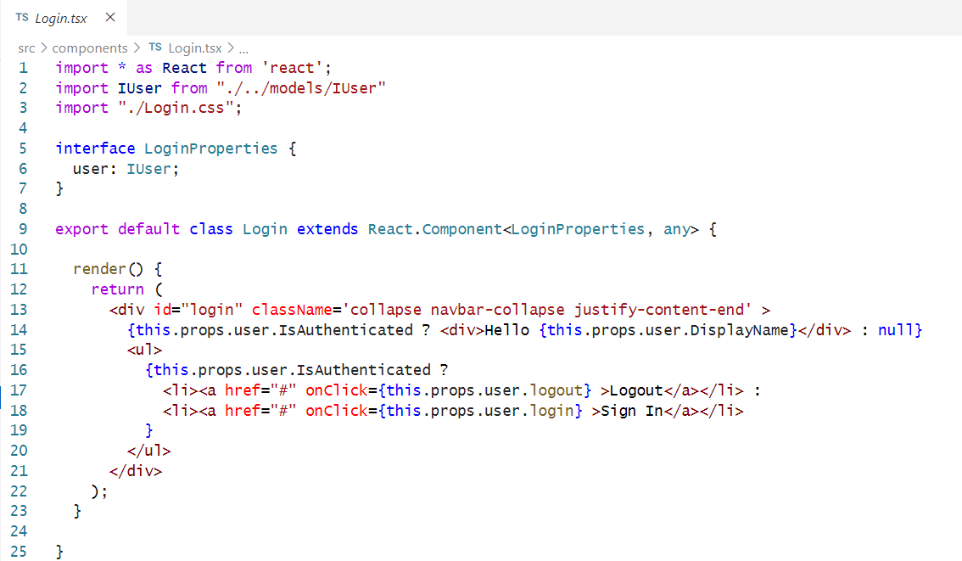
User Login and Authentication

Slide 28
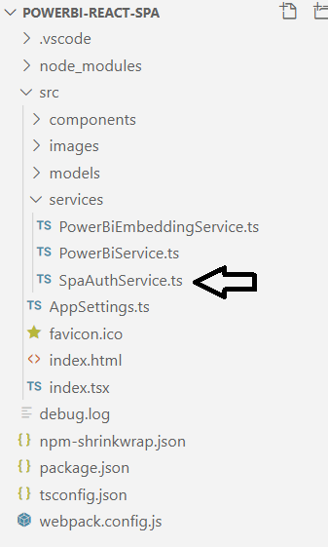
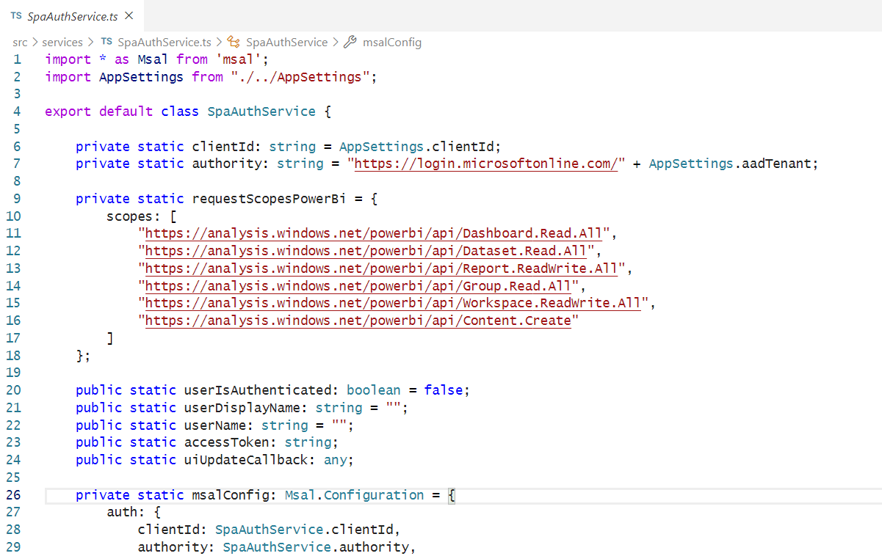
SpaAuthService.ts

Slide 29
Agenda
Getting Started with React.js
Creating SPAs using React.js, TypeScript and Webpack
Authenticating the User using Azure AD
Extending a React Project with the React Router
Calling the Power BI Service API using Fetch
Embedding Power BI Reports
The Power BI React Component

Slide 30
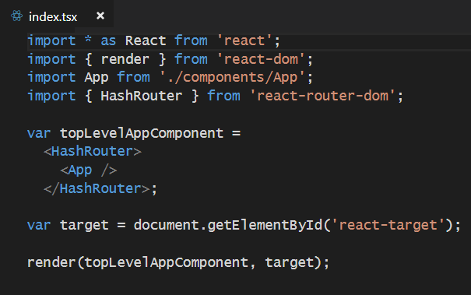
React Router
Used to create route map in single page application (SPA)
Installed as a pair of npm packages
npm install react-router @types/react-router --save-dev
npm install react-router-dom @types/react-router-dom --save-dev
Router must be added in as top-level component above App

Slide 31

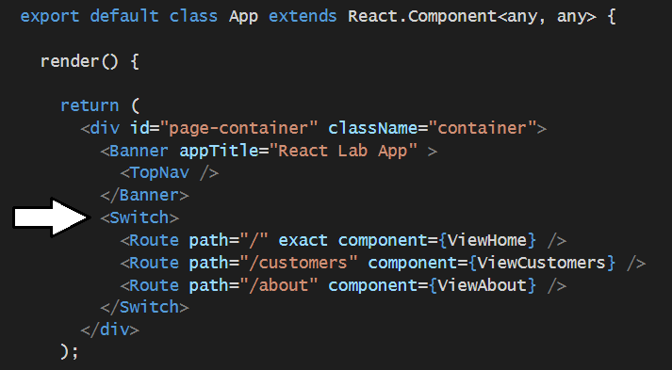
Using React Router
Import Route and Switch components
Create route map in HTML output

Slide 32
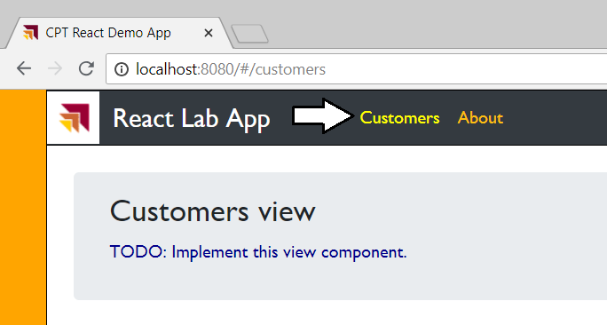
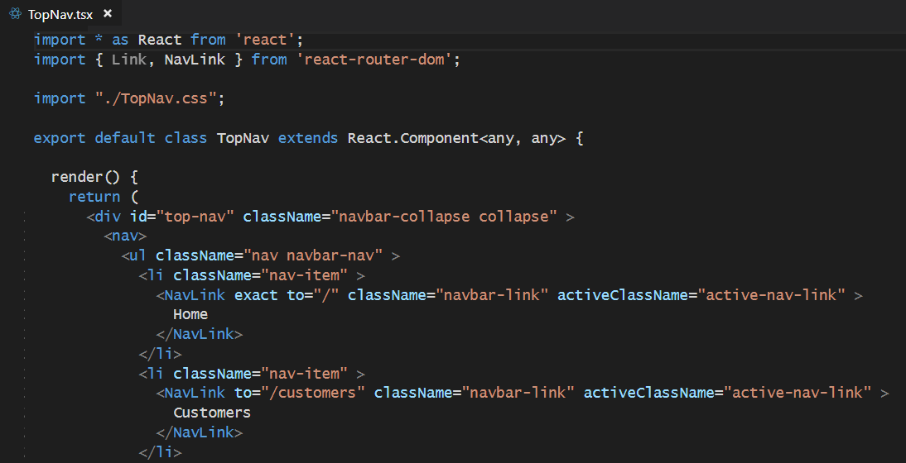
Creating Route Links

Slide 33
Agenda
Getting Started with React.js
Creating SPAs using React.js, TypeScript and Webpack
Authenticating the User using Azure AD
Extending a React Project with the React Router
Calling the Power BI Service API using Fetch
Embedding Power BI Reports
The Power BI React Component

Slide 34
Component Lifecycle Methods
componentDidMount
executed after node is added to the DOM
componentDidUpdate
executed after component is rendered
executed before node is added to the DOM
shouldComponentUpdate(newProps, newState)
executed before component is updated

Slide 35
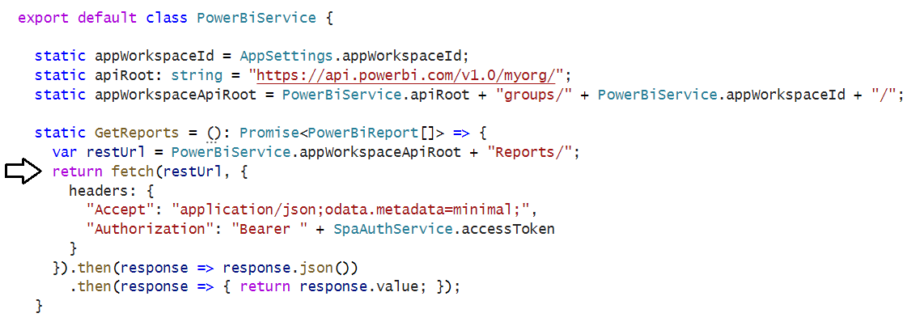
Calling a Web Service using the Fetch API

Slide 36
Agenda
Getting Started with React.js
Creating SPAs using React.js, TypeScript and Webpack
Authenticating the User using Azure AD
Extending a React Project with the React Router
Calling the Power BI Service API using Fetch
Embedding Power BI Reports
The Power BI React Component

Slide 37
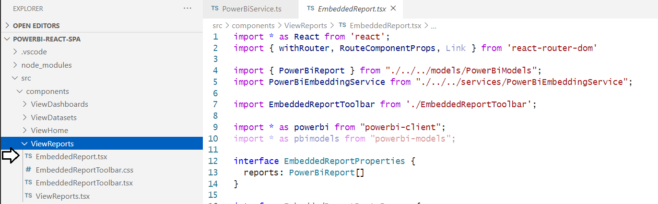
Embedding Power BI Reports

Slide 38
Agenda
Getting Started with React.js
Creating SPAs using React.js, TypeScript and Webpack
Authenticating the User using Azure AD
Extending a React Project with the React Router
Calling the Power BI Service API using Fetch
Embedding Power BI Reports
The Power BI React Component

Slide 39
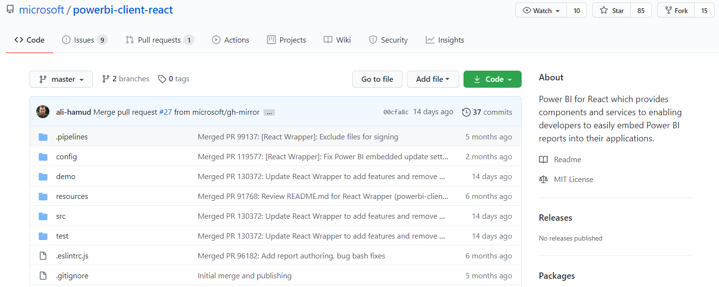
Power BI React Component https://github.com/microsoft/powerbi-client-react

Slide 40
Summary
Getting Started with React.js
Creating SPAs using React.js, TypeScript and Webpack
Authenticating the User using Azure AD
Extending a React Project with the React Router
Calling the Power BI Service API using Fetch
Embedding Power BI Reports
The Power BI React Component

Slide 41
Questions

